Slide 1
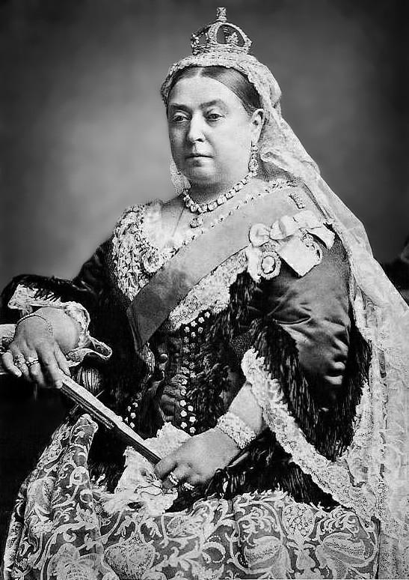
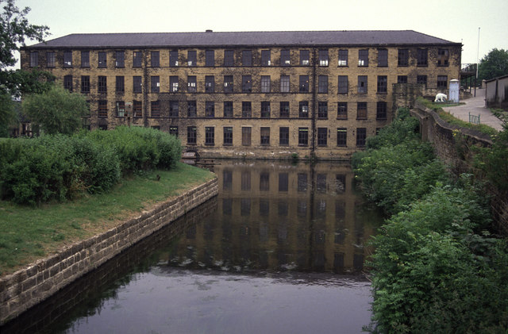
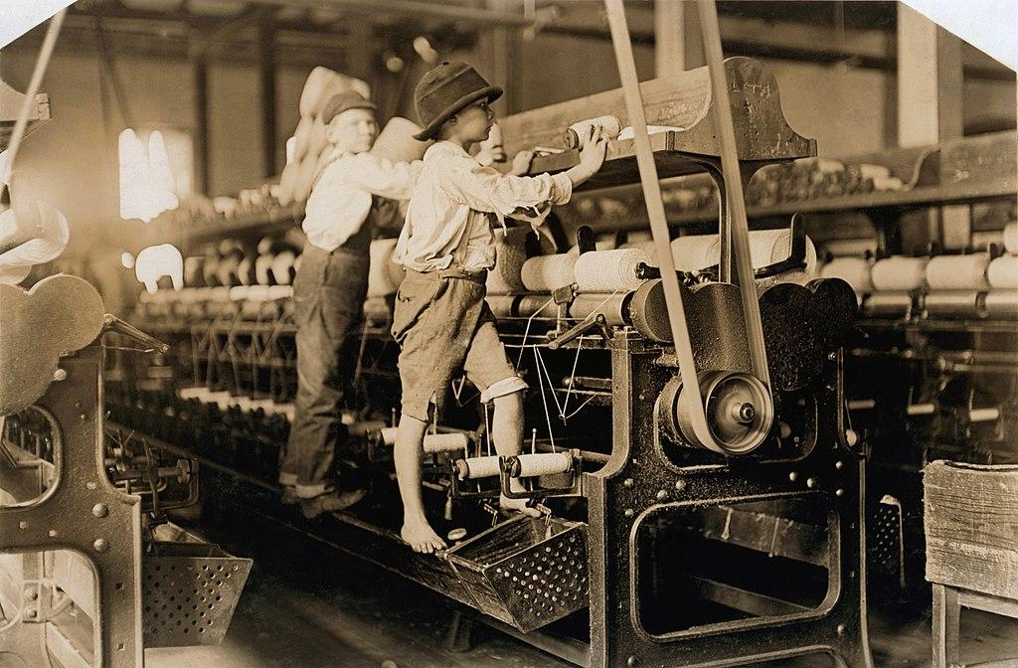
History: The Victorians and how the Industrial Revolution transformed Leeds
A mill building located in Armley
Victorian children working in a mill
Queen Victoria
1819-1901
A timeline of the Victorian era
1891- education act makes education compulsory and free for children aged 5 -13
1837
Victoria ascends the throne.
1844 factory act states children should start work at aged 8
1867 all workers limited to a 10 hour work day
1840
First ragged school set up
1847 Factory act states women and children can only work 10 hours a day
1870- Dr Bernardo opens homes for the poor giving them access to food and shelter
1901
Victoria dies and her reign ends

Slide 2
Vocabulary:
Industrial Revolution- The change from creating things by hand to creating things with machines
Innovation- The act of adapting or improving something
Sanitisation- the act of making something clean and free from bacteria.
Industry- activity linked to making goods and services
workhouse- an institution in which poor and vulnerable people were given shelter and food in return for work.
rights- a moral and legal entitlement to do or have something
Essential Learning
The Victorian era was named after Queen Victoria.
The Victorian era saw rapid change and development in industry and transport. This is known as the Industrial Revolution.
Leeds grew from a town into a city as a result of the Industrial Revolution.
Many people in Leeds worked in mills. The conditions were dangerous because of the types of machinery and the number of people working there.
Life for some children in Victorian times involved dangerous work in a mill then going to school.

